Slide 1
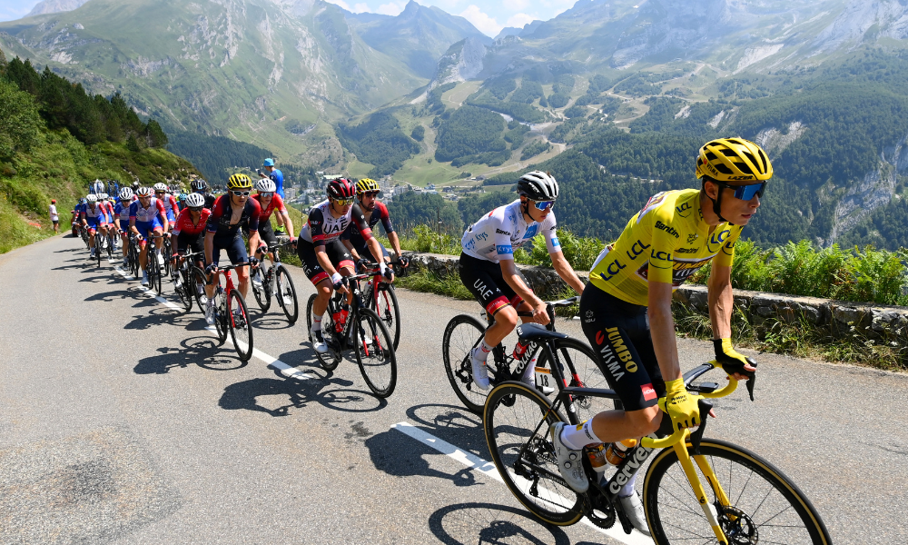
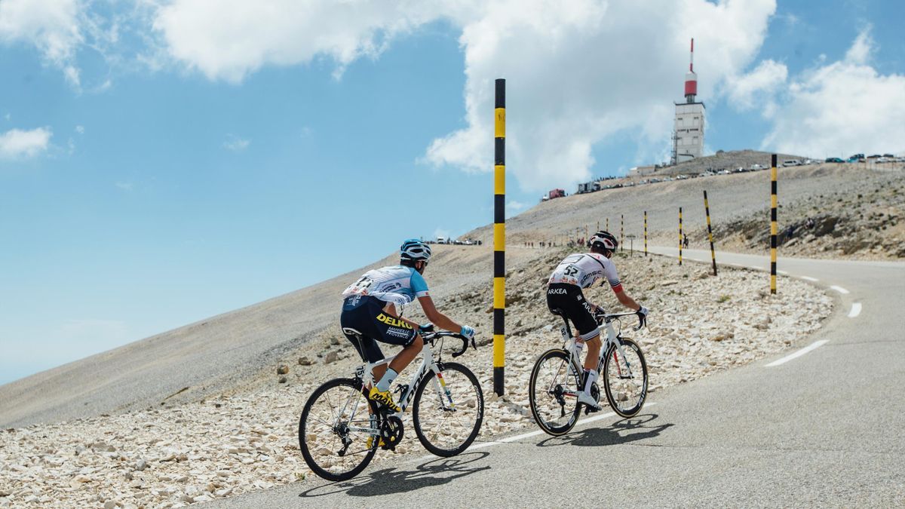
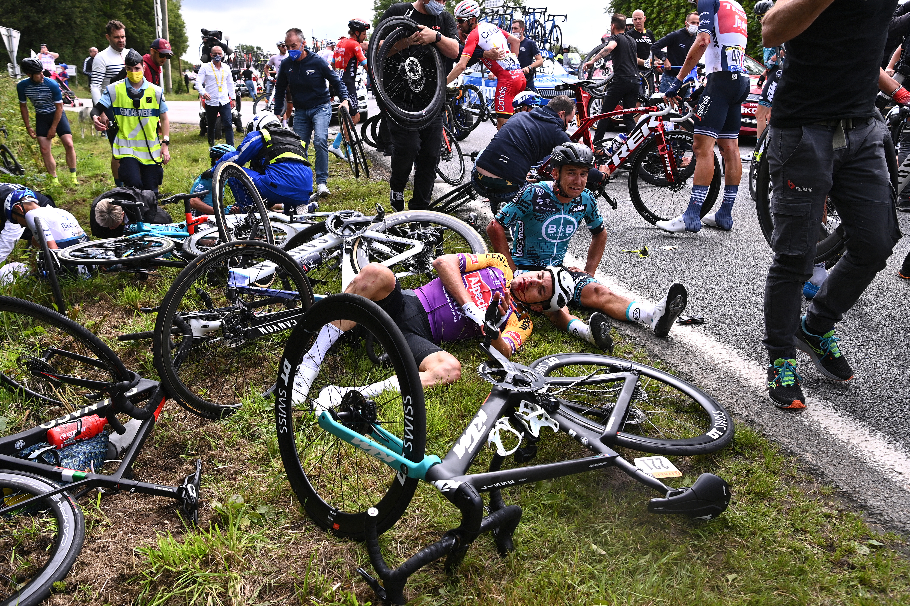
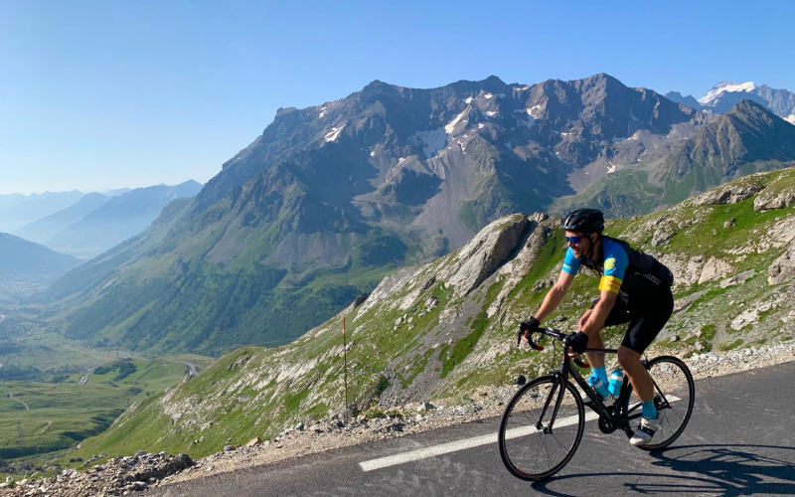
WHAT MINISTRY FEELS LIKE

Slide 2
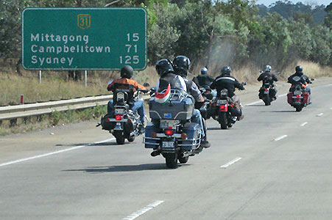
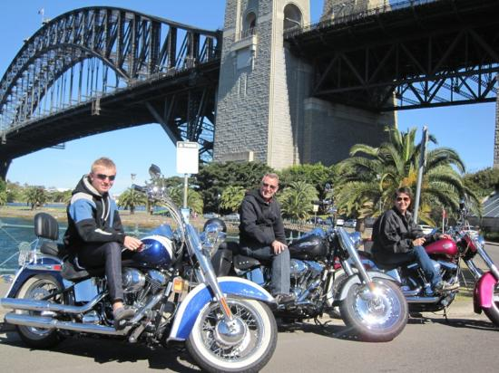
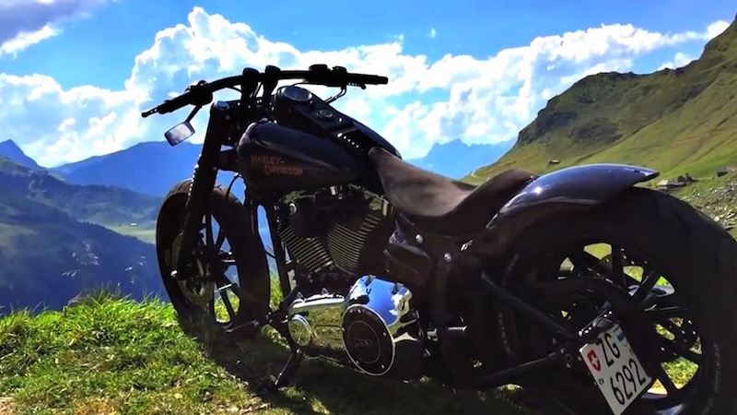
WHAT I WANT IT TO BE

Slide 3
WHAT ARE WE DOING HERE?
Me — a 60 year old novice
You — a captive audience
Let’s expose the elephant…

Slide 4
THE ROYAL COMMISSION
Undertake mandatory, regular professional development, compulsory components being professional responsibility and boundaries, ethics in ministry and child safety
Undertake mandatory professional/pastoral supervision
Undergo regular performance appraisals.

Slide 5
WHAT IS SUPERVISION?
Supervision interrupts practice. It wakes us up to what we are doing. When we are alive to what we are doing, we wake up to what is, instead of falling asleep in the comfort stories of our routines and daily practice.
Sheila Ryan, Vital Practice. 2004

Slide 6
PASTORAL SUPERVISION
Supervision provides an opportunity to reflect on our practice in the light of our theology. It’s time-out from the day-to-day stuff of what we do to think about why we do it.
Mike Dicker. Youthworks College Blog, 19 March 2019.

Slide 7
PASTORAL SUPERVISION
professional supervision with a trained professional or pastoral supervisor who has a degree of independence from the institution within which the person is in ministry.
Royal Commission Report. Recommendation 16:45.

Slide 8
WHY SUPERVISION?
BETTER TO GO TOGETHER
RELATIONSHIPS
DANGERS
EXPERIENTIAL LEARNING
PRACTICAL THEOLOGY
EFFECTIVENESS vs EFFICIENCY
BUILDING RESILIENCE

Slide 9
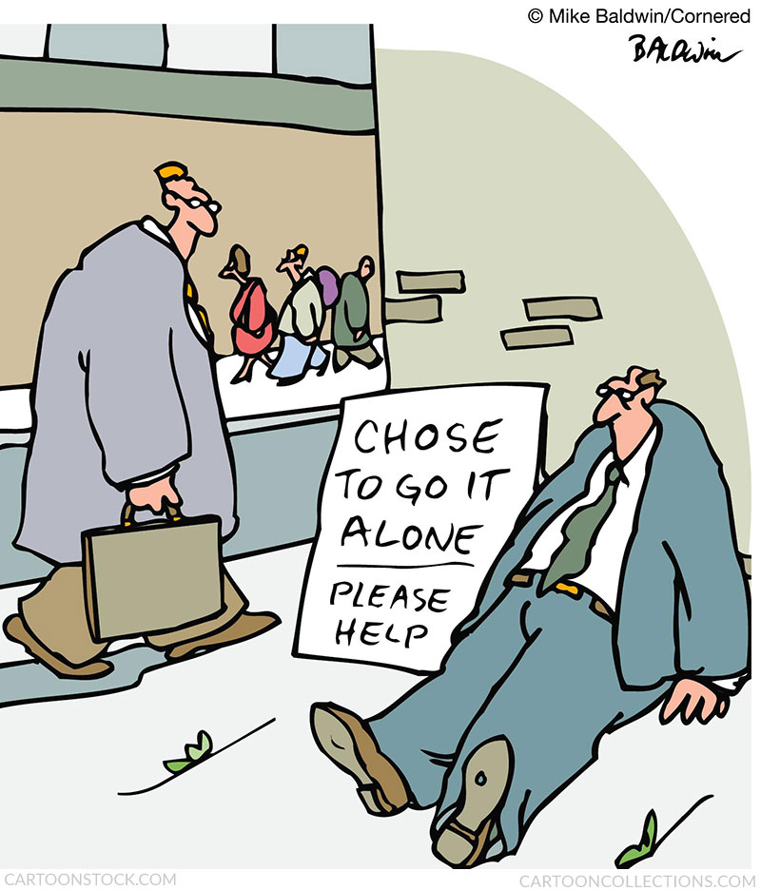
BETTER TO GO TOGETHER
If you want to go faster, go alone.
If you want to go far, go together.
African proverb

Slide 10
RELATIONSHIPS
BACK
STAGE
ON
STAGE
OFF
STAGE

Slide 11
DANGERS
YOU
(eg. stress, burnout)
CHURCH
(eg. drift, abuse)
COMMUNITY

Slide 12
EXPERIENTAL LEARNING
KOLB’S FOUR STAGES OF EXPERIENTIAL LEARNING
experientiallearninginstitute.org

Slide 13
PRACTICAL THEOLOGY
Intentional Ministry Reflection
Descriptive stage Slowing down to notice the details of the event.
Exploratory stage Identifying what’s going on for you in this event.
Assess stage Measuring your knowledge against your values.
Enact stage Growing from the event.
Archie Poulos. MTC 4th Year Program.

Slide 14
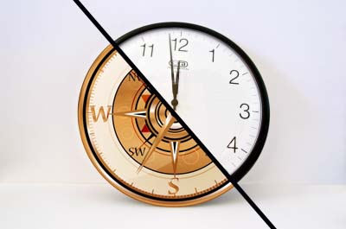
EFFECTIVENESS vs EFFICIENCY

Slide 15
EFFECTIVENESS vs EFFICIENCY
I spent much of my early ministry life avoiding reflection because I was too busy. In reality, my lack of reflection was a symptom of living in reactivity… Taking time out in supervision and stepping back to see the big picture has helped me to say no more often and live a more thoughtful and healthily balanced ministry life.
Paul Grimmond. Dean of Students Moore College.

Slide 16
BUILDING RESILIENCE
But we have this treasure in jars of clay to show that this all-surpassing power is from God and not from us. We are hard pressed on every side, but not crushed; perplexed, but not in despair; persecuted, but not abandoned; struck down, but not destroyed.
2 Corinthians 4:7-9 NIV

Slide 17
SHOW VIDEO

Slide 18
6 IMAGES FOR SUPERVISION
PIT-HEAD TIME
MOBIUS STRIP
REMOTE CONTROL
ROOM WITH A VIEW
FRESH PERSPECTIVES
THREE-LEGGED STOOL

Slide 19
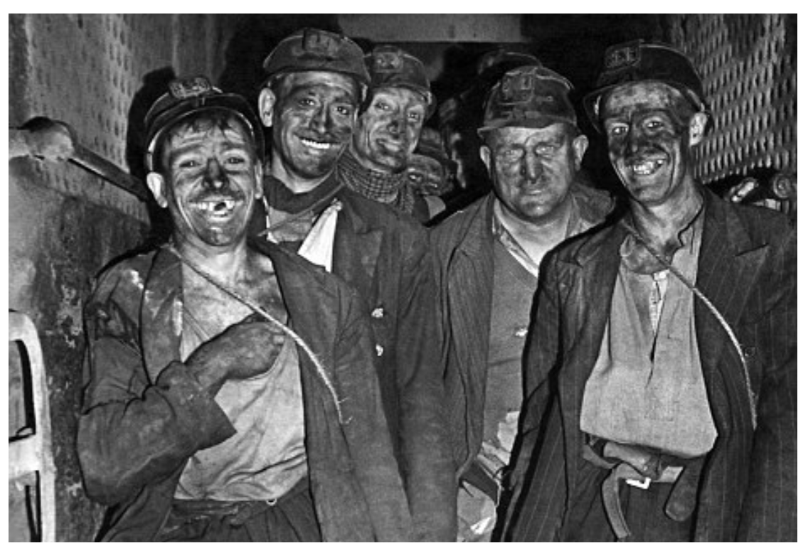
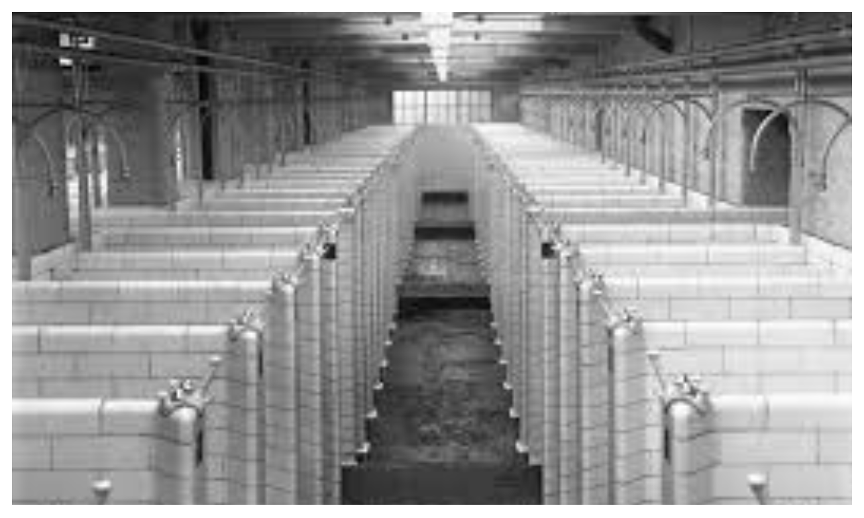
PIT-HEAD TIME
IMAGES Courtesy Geoff Broughton, GCPS

Slide 20
MOBIUS STRIP

Slide 21
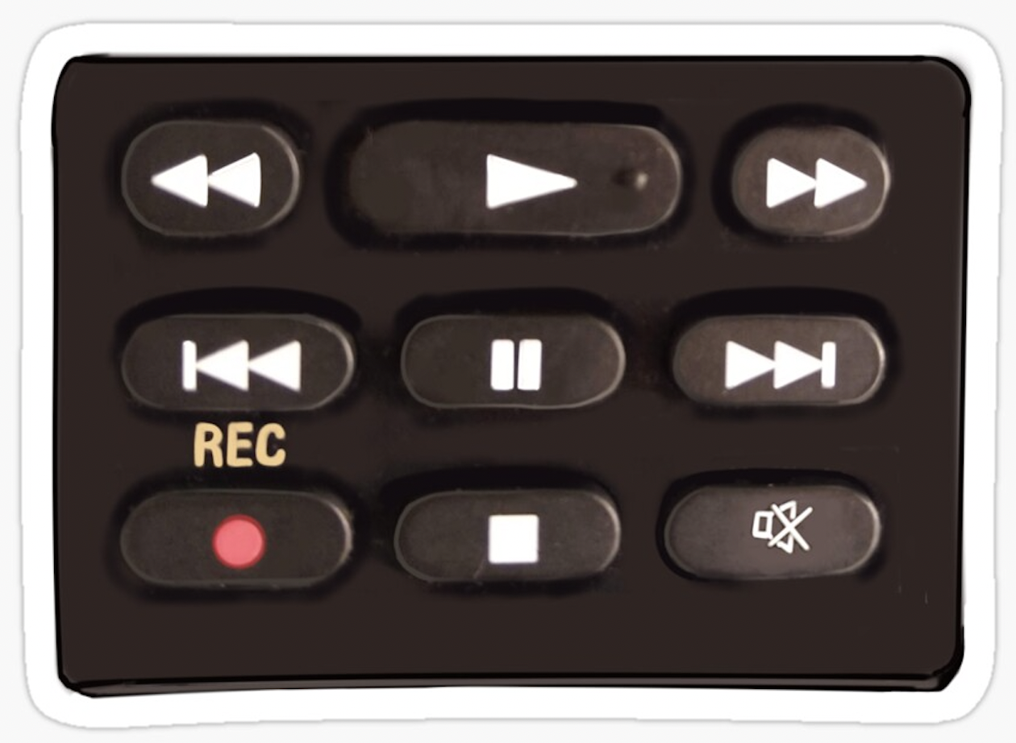
REMOTE CONTROL

Slide 22
ROOM WITH A VIEW

Slide 23
FRESH PERSPECTIVES

Slide 24
THREE-LEGGED STOOL
FORMATIVE
NORMATIVE
RESTORATIVE
Inskipp and Proctor, 1993

Slide 25
FORMATIVE
Learning
postural
theological
critical
emotional/personal
visional
transformational

Slide 26
RESTORATIVE
Support
gospel-focused
shepherd/sheep
capacity
prayerful dependence
declutter
debrief
detox
You’re only human and you’re not the only human.

Slide 27
NORMATIVE
Alignment
Faithfulness in Service
practical theological reflection
Integrity
boundaries
warning signs
Compliance to the Code vs Conforming to Christ

Slide 28
3 DISCIPLINES
COACHING
MENTORING
SUPERVISION

Slide 29
MENTORING
A mentor is someone who shares their knowledge, skills, and/or experience, to help another to develop and grow.

Slide 30
SHOW MENTORING VIDEO

Slide 31
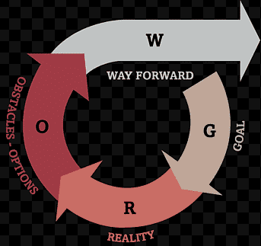
COACHING
G.R.O.W.
Goal
Reality
Options or Obstacles
Way forward

Slide 32
PASTORAL SUPERVISION
Relational
Listening
Developmental
Reflective practice focus
COACHING
MENTORING
Unseen others
Goal focus
Personal focus

Slide 33
FINAL EXHORTATION
Be shepherds of God’s flock that is under your care, watching over them—not because you must, but because you are willing, as God wants you to be; not pursuing dishonest gain, but eager to serve; not lording it over those entrusted to you, but being examples to the flock. And when the Chief Shepherd appears, you will receive the crown of glory that will never fade away.
1 Peter 1:2-4 NIV

